Slide 1

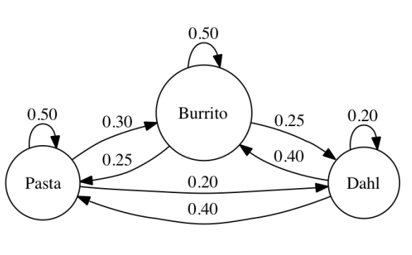
Workshop: Decision modelling in R
Stan Wijn MSc 08-03-2019

Slide 2
Today
Why build a decision model in R?
Exercise 1: Decision tree
Exercise 2: Markov model

Slide 3

Disclaimer
All information is based on the workshop hosted by the DARTH workgroup and my own experience.
If you use the pre-written code in your article, please cite there publication:
Jalal H, et al. An Overview of R in Health Decision Sciences. Med. Decis. Making. 2017; 37(3): 735-746.
Krijkamp EM, et al. Microsimulation modeling for health decision sciences using R: a tutorial. Med. Decis. Making. 2018; (in press).

Slide 4
1. Why build a decision model in R

Slide 5
Current decision modeling software
Specialized decision modeling software
TreeAge, Data, Crystal8, Arena etc.
Spreadsheet software
Microsoft Excel, Open/Libre Office
Statistical/ Computer programing software
Matlab, R, C++, Python, WinBUGS, etc

Slide 6

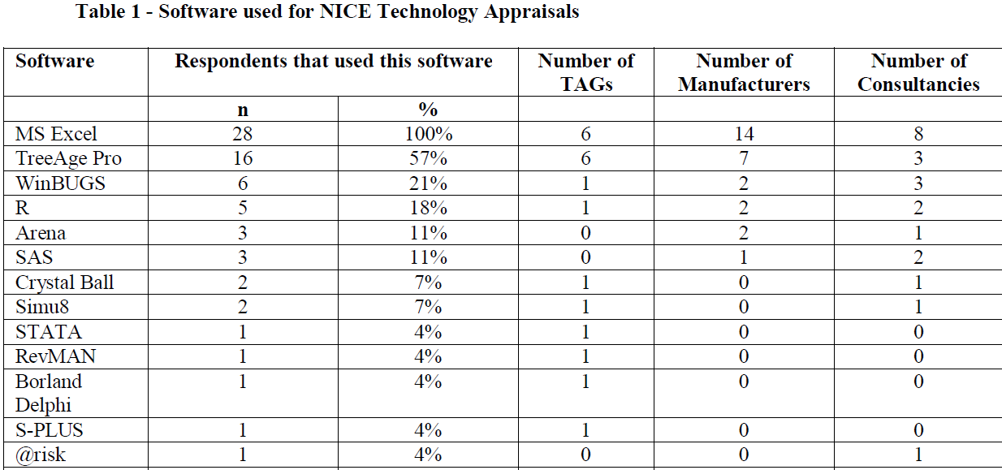
Survey:
Main concerns:
-More complex modelling, including patient level simulations
-Commercial and black box
-NICE: licensing and validation issues in appraisals.
https://www.ncbi.nlm.nih.gov/pubmed/28481489 - 2018
Notes:
The aim of this review was to inform the update of the NICE Technology Appraisal software requirements for economic model submissions. An online survey of key stakeholders submitting economic models for NICE technology appraisals was conducted to assess the capacity to use different software packages for economic modelling (development and review). The survey also asked stakeholders to describe the strengths and weaknesses of alternative software packages. 44 stakeholders were invited to the survey, with 33 (75%) providing a response. MS Excel had been used by 100% of respondents, with TreeAge Pro the next most common (57%). The statistical language R had been used 3 times in a submission to NICE. The main concerns noted were the ability of MS Excel and TreeAge Pro to undertake more complex modelling, including patient level simulations. However, respondents noted that many simulation software packages are commercial and black box, which may have licensing and validation issues for NICE appraisals. There was no strong consensus about whether NICE should formally accept models developed in software packages other than MS Excel and TreeAge Pro. Some respondents were concerned with the cost and training implications, in particular for review groups, while others strongly favoured the use of other software.

Slide 7
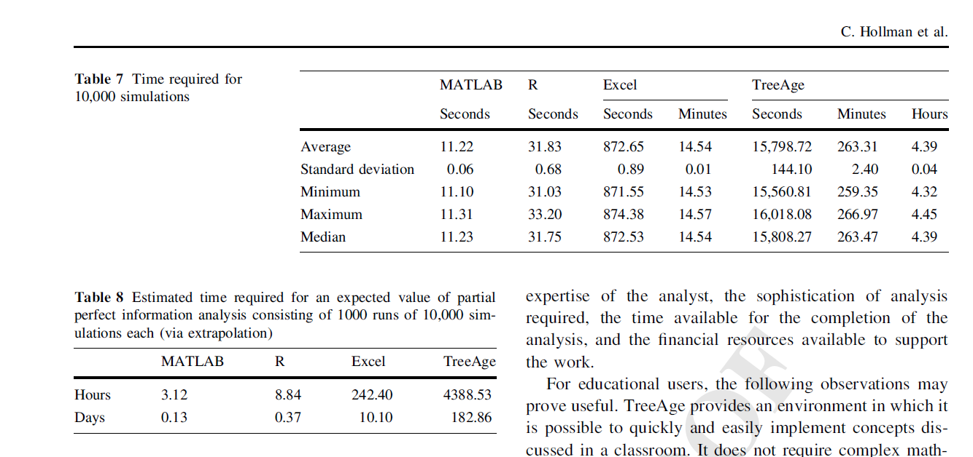
It is fast!
Individual model Tim: 100.000 simulations in 9.8 seconds!

Slide 8


Slide 9
When to build a decision model in R
A model that is too complex to be designed easily in TreeAge or Excel.
You care about execution time and computational efficiency.
Want to create a web-based tool for the end-user to improve interpretation of the results
You want to embed statistical models and the associated uncertainty.
You want to have a transparent decision model with open access to any user.
Notes:
When want to implement new methods that haven’t already been incorporated in traditional canned softwares

Slide 10
How?

Slide 11
Conceptualizing a decision model in R
INPUT: Load input data relevant to the decision model
INITIALIZATION: Declare and initialize all variables that will be used to store information in the decision model. The dimensions of the variables are defined.
MODEL: The main component of the decision model; here is where the model outcomes (expected costs, expected outcomes, incremental costs and effects and incremental cost-effectiveness/net-benefits etc) are estimated.
OUTPUT: Tabular and graphical representation of the findings.

Slide 12
2. Practice Decision tree

Slide 13
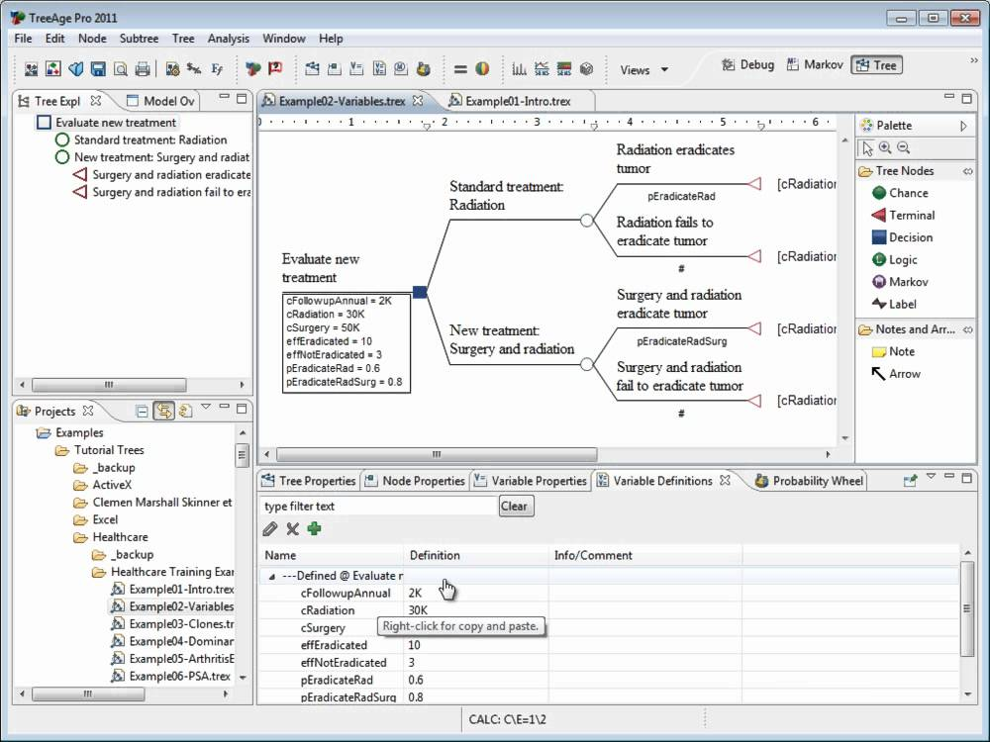

Slide 14
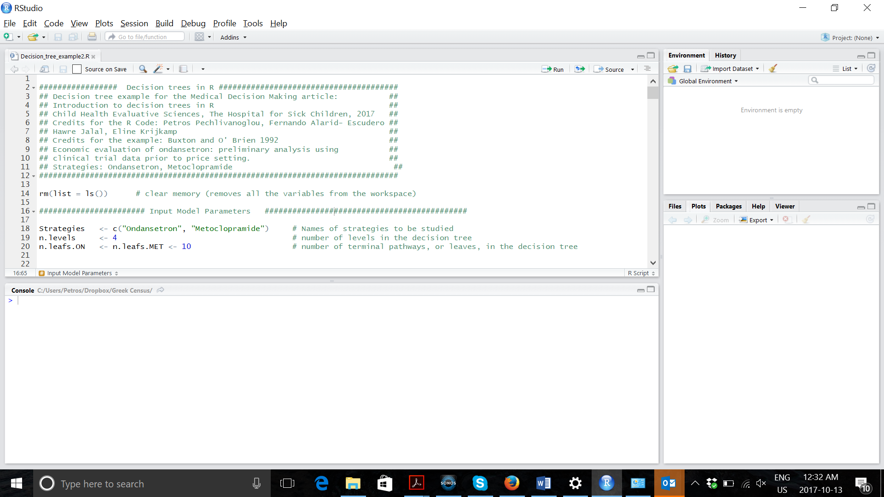

Slide 15
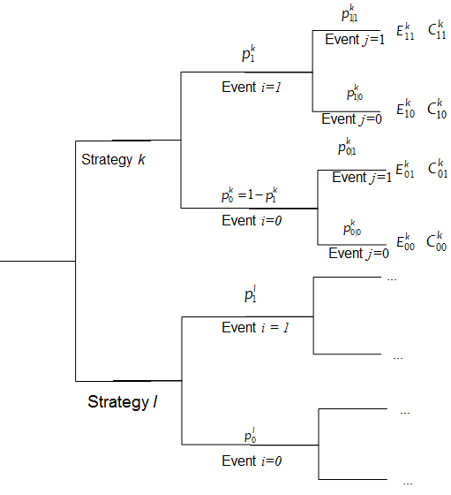
The Decision Tree

Slide 16

Inputting data in R
Input
: Probability of an event i in treatment k.
: Conditional probability of event j given event i in treatment k.
: Effectiveness associated with experiencing the combination of events i and j in treatment k.
: Costs associated with experiencing the combination of events i and j in treatment k.

Slide 17
Example Decision Tree
Estimating the cost-effectiveness of three follow-up practices for colorectal cancer after colorectal cancer treatment (Gray et al, 2011).
Follow-up in primary care (PC),
Follow-up in hospital care (HC) or
Continue routine practice (RP).
Strategies are different on:
Probability of early detection (ed) vs late detection (ld) of recurrence of colorectal cancer
Follow-up costs (C) in UK pounds.
Differences in early detection rates are associated with life expectancy (LE)

Slide 18
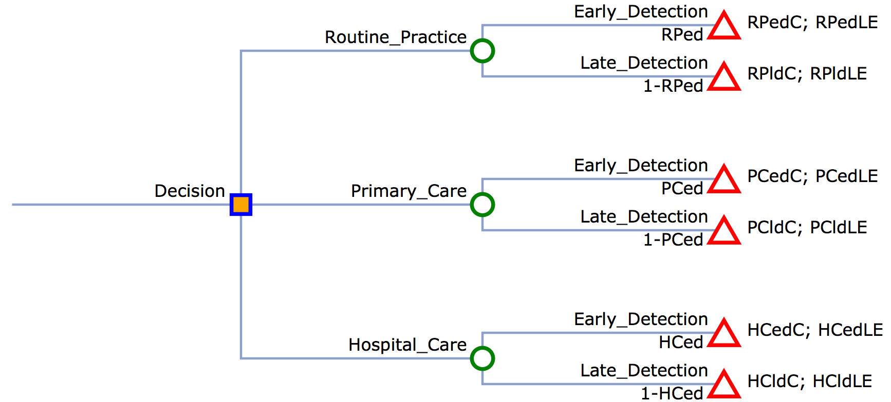
Example Decision Tree
c.RPed; e.RPed
c.RPld; e.RPld
c.PCed; e.PCed
c.PCld; e.PCld
c.HCed; e.HCed
c.HCld; e.HCld

Slide 19
General tips
Before you start, select a work-directory (to save your scripts)
Bottom-right, select Files tab and navigate to your folder. Then click More (gear icon in the top) and “set as working directory”
Assign variables using “<-” (shortkey alt and minus (-) )
Select multiple rows using alt + drag with mouse
Vocabulary:
Vector: a line of numbers (1,2,3,4,5,6) assigned using c(1,2,3,4)
Matrix: multiple vectors in a matrix structure (only numbers)
Data.frame: matrix that can contain more then numbers (text)
Factor: Categorical variable

Slide 20
General tips
For PSA:
Use rnorm, rbeta, rgamma and for normal, beta and gamma resp.
Rnorm(1, mean, sd)
Rbeta(1, a, b)
Rgamma(1, shape, scale)
Or Rgamma(1, shape = mean^2 / sd^2, rate = mean / sd^2)

Slide 21
R Session – Decision Tree https://github.com/StanWijn/DMIG
“Your dedication is inspiring!”

Slide 22
3. Practice Markov models

Slide 24
Building a state transition cohort Model
Load model parameters
Determine health states
Determine transitions
Choose cycle length
Estimate transition probabilities
Estimate state utilities and costs per cycle
Calculate
Results & plots
(Sensitivity analysis)
Input
Initialization
Model
Output

Slide 25
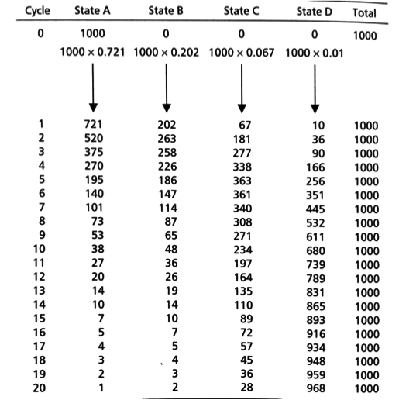
Markov
Trace
Number or distribution of individuals at each cycle

Slide 26
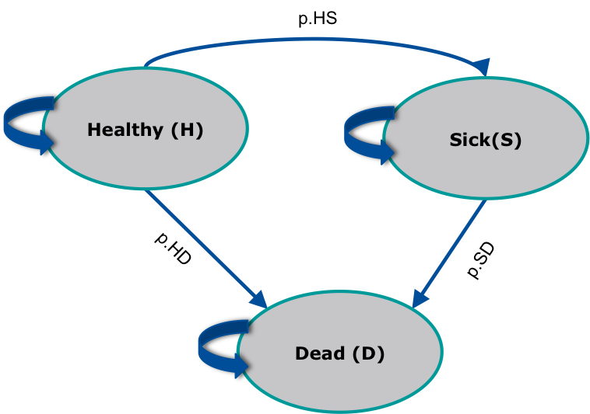
Healthy - Sick - Dead

Slide 27
Transitioning
Summarize transition probabilities as a matrix
Cohort distribution at next time step calculated through matrix multiplication
To:
 | Healthy | Sick | Dead
Healthy | 0.75 | 0.20 | 0.05
Sick | 0 | 0.85 | 0.15
Dead | 0 | 0 | 1.0
From:
= A
A
x₀
x₁
1.0
0.0
0.0
=

Slide 28
Review – Markov Models
Summarize transition probabilities as a matrix
Cohort distribution at next time step calculated through matrix multiplication
To:
 | Healthy | Sick | Dead
Healthy | 0.75 | 0.20 | 0.05
Sick | 0 | 0.85 | 0.15
Dead | 0 | 0 | 1.0
From:
= A
A
x₀
0.75
0.20
0.05
x₁
1.0
0.0
0.0
0
0.85
0.15
=
0.75
0.20
0.05
0
0
1.0

Slide 29
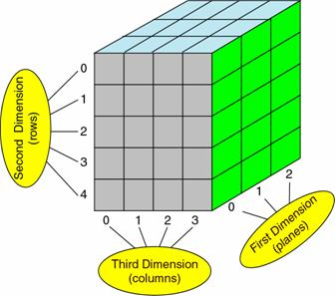
Cycle dependancies?
3D-array of transition probabilities
Cycles
To: health states
From: health states

Slide 30
Building the Markov model in R

Slide 31
Demo Healthy – Sick- Dead

Slide 32
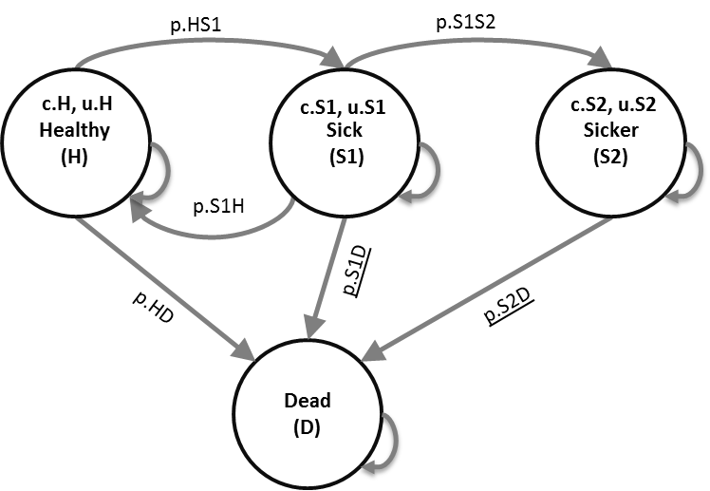
R Session – Markov Model https://github.com/StanWijn/DMIG
Notes:
Part 1 = Showing code 3 state model
Part 2 = Exercise build Sick-Sicker model
Part 3 = Show answers of Sick-Sicker

Slide 33
PSA?

Slide 34
Why R? - take home
Freely available and open-source
Results are open, reproducible and sharable
no “point-and-click” steps
Integrate statistical analyses with modeling
Parameter estimation
Analysis / visualization of results
Accommodates the complexity of microsimulation
Flexibility to implement any desired modeling structure
Computational efficiency (fast)

Slide 35
Conclusion
No software platform is perfect but:
R offers potential for transparency, reproducibility, incorporating model complexity, improved performance, a unified framework, a great educational platform GUI capabilities, which is FREE!
The price to pay: Steep learning curve, Programming skills, Poorer GUI compared to other software Poorer documentation

Slide 36
Literature:
Tutorial Microsimulation:
http://journals.sagepub.com/doi/full/10.1177/0272989X18754513
General overview of R modelling:
http://journals.sagepub.com/doi/abs/10.1177/0272989X16686559?url_ver=Z39.88-2003&rfr_id=ori:rid:crossref.org&rfr_dat=cr_pub%3dpubmed

Slide 37


